Slide 1
Wikipedia

Slide 2
Wikipedia is a free, open content online encyclopedia created through the collaborative effort of a community of users known as Wikipedians.
Anyone registered on the site can create an article for publication; registration is not required to edit articles.
A wiki is a hypertext publication collaboratively edited and managed by its own audience directly.
A typical wiki contains multiple pages for the subjects or scope of the project and could be either open to the public or limited to use with in organization for maintaining its internal knowledge base.

Slide 3
A wiki enables communities of editors and contributors to write documents collaboratively. All that people require to contribute is a computer, Internet access, a web browser, and a basic understanding of a simple markup language (e.g. MediaWiki markup language).
A single page in a wiki website is referred to as a "wiki page", while the entire collection of pages, which are usually well-interconnected by hyperlinks, is "the wiki". A wiki is essentially a database for creating, browsing, and searching through information. A wiki allows non-linear, evolving, complex, and networked text, while also allowing for editor argument, debate, and interaction regarding the content and formatting

Slide 4
Editing
"Wikitext" redirects here. For the Wikipedia help page, see Help:Wikitext.
Source editing
Some wikis have an Edit button or link directly on the page being viewed if the user has permission to edit the page. This can lead to a text-based editing page where participants can structure and format wiki pages with a simplified markup language, sometimes known as wikitext, wiki markup or wikicode (it can also lead to a WYSIWYG editing page; see the paragraph after the table below). For example, starting lines of text with asterisks could create a bulleted list.

Slide 5
Layout consistency
Wikis have favored plain-text editing, with fewer and simpler conventions than HTML for indicating style and structure. Although limiting access to HTML and Cascading Style Sheets (CSS) of wikis limits user ability to alter the structure and formatting of wiki content, there are some benefits.
Visual editing
Wikis can also make WYSIWYG editing available to users, usually through a JavaScript control that translates graphically entered formatting instructions into the corresponding HTML tags or wikitext. In those implementations, the markup of a newly edited, marked-up version of the page is generated and submitted to the server transparently, shielding the user from this technical detail. An example of this is the VisualEditor on Wikipedia.

Slide 6
Version history
Some wikis keep a record of changes made to wiki pages; often, every version of the page is stored. This means that authors can revert to an older version of the page should it be necessary because a mistake has been made, such as the content accidentally being deleted or the page has been vandalized to include offensive or malicious text or other inappropriate content.
Edit summary
"Edit summary" redirects here. For the Wikipedia help page, see Help:Edit summary.
Many wiki implementations, such as MediaWiki, the software that powers Wikipedia, allow users to supply an edit summary when they edit a page. This is a short piece of text summarizing the changes they have made

Slide 7
Navigation
Within the text of most pages, there are usually many hypertext links to other pages within the wiki. This form of non-linear navigation is more "native" to a wiki than structured/formalized navigation schemes. Users can also create any number of index or table-of-contents pages, with hierarchical categorization or whatever form of organization they like
Linking and creating pages
Links are created using a specific syntax, the so-called "link pattern". Originally, most wikis^{[citation needed]} used CamelCase to name pages and create links. These are produced by capitalizing words in a phrase and removing the spaces between them (the word "CamelCase" is itself an example). While CamelCase makes linking easy, it also leads to links in a form that deviates from the standard spelling.

Slide 8
Trust and security
Controlling changes
Trustworthiness and reliability of content
Security

Slide 10
LinkedIn

Slide 11
LinkedIn is a social networking site designed specifically for the businesscommunity.
The goal of the site is to allow registered members to establish and document
networks of people they know and trust professionally.

Slide 12
Platform and features
User profile network
Embedded in profile
Mobile
Knowledge graph
Personal branding

Slide 13
Google – advertising

Slide 14
Google Ads is Google's online advertising program. Through Google Ads, you can create online
ads to reach people exactly when they're interested in the products and services that you offer.
Google Ads is a product that you can use to promote your business, help sell products or services,raise awareness, and increase traffic to your website.

Slide 15
Google Ads Appear
The Google Ads auction is focused around keywords – advertisers choose a list of
keywords to target that are relevant to their business offerings, the words that people are
most likely to use when searching for their product.

Slide 16
Google Ads work
Google Ads operates under a pay-per-click (PPC) model. That means marketers
target a specific keyword on Google and make bids on the keyword — competing with
others also targeting the keyword.

Slide 17
Marketers have three options for their bids:
1. Cost-per-click (CPC). How much you pay when a user clicks on your ad.
2. Cost-per-mille (CPM). How much you pay per 1000 ad impressions.
3. Cost-per-engagement (CPE). How much you pay when a user performs aspecific action on your ad (signs up for a list, watch a video, etc).

Slide 18
Google analytics

Slide 19
Google Analytics is a web analytics service that provides statistics and basic analytical tools for search engine optimization (SEO) and marketing purposes. The service is part of the Google Marketing
Platform and is available for free to anyone with a Google account.

Slide 20
Types of data
1. User acquisition data
2. User behavior data

Slide 21
How does Google Analytics work?
Google Analytics acquires user data from each website visitor through the use of page tags.
A JavaScript page tag is inserted into the code of each page. This tag runs in the web browser of eachvisitor, collecting data and sending it to one of Google's data collection servers.

Slide 22
Google Analytics, which aggregates it into four levels:
User Level (the actions of each user)
Session Level (the individual visits)
Pageview Level (the individual pages visited)
Event Level (video views, button clicks and similar actions)

Slide 23
Google ads visibility

Slide 24
Google Ads is a popular online advertising platform. It is useful in reaching your target audience,but like everything related to Google, it is constantly evolving. As a result, even experienced marketers
can have some difficulty keeping up.

Slide 25
Active view
Active View is a technology on YouTube and certain Display Network websites and apps that
allows Google Ads to determine if your ad is viewable by potential customers.

Slide 26
viewable ad
Active View metrics have been created in compliance with industry standards for measuring
the viewability of online ads, as developed by the Media Rating Council (MRC). According to MRCguidelines, the standard for measuring the viewability of ads

Slide 27
Active View metrics
Measurable impression
Viewable impression
Viewable rate
Measurable rate
Viewable CTR

Slide 29
Bulk emailing essentials

Slide 30
Bulk email marketing is an email sent to large groups of people at once to advertise the
goods or services provided by a business or maintain a relationship with customers. When done right, it allows us to increase the number of loyal clients and boost ROI.

Slide 31
Two Types of Bulk Emails
Legitimate bulk emails
Unsolicited bulk emails

Slide 32
Benefits of Bulk Email Marketing
Allows real-time messaging
Enables marketers to send personalized messages
Helps in mailing list segmentation
Offers information sharing

Slide 33
How to Do Bulk Email Marketing
Identify your target audience
Focus on the benefits
Give special discounts

Slide 34
Integration of social media buttons into business website

Slide 35
Social media integration gives your audience more way to engage & interact with your brand.
You are creating more opportunities for them to share your content & promote services for you. It is easy to do.

Slide 36
Guidelines for Integrate social media onto your website
Add social sharing link to your blog post
• Add social post to your website
• Create social login
• Add social sharing link to your footer

Slide 37
Way to integrate social media into your website:
Social media Icon
Social share button
Social Login Plugins
Social Live Feeds
Social Assistance Account

Slide 40
Campaign budgeting

Slide 41
A marketing budget outlines all the money a business intends to spend onmarketing-related projects over the quarter or year.
Marketing budgets can includeexpenses such as paid advertising, sponsored web content, new marketing staff, aregistered blog domain, and marketing automation software.

Slide 42
Marketing Budget for Small Business
Marketing budgets are especially important for small businesses.
Small businessowners may lack the experience drawing up budgets; moreover, it's critical that these companies keep costs as low and lean as possible as they scale.

Slide 43
How much should a company spend on marketing?
This includes initiatives that cater to audiences on desktop computers, search engines, video streaming platforms, social media, and mobile devices.

Slide 44
Marketing Costs
Software
Freelancers
New Personnel
Advertising
Content Creation

Slide 45
Cost control

Slide 46
Cost Control is one of the most efficient tools that businesses use to decrease the production cost.
In this, important details are provided to the management, so they can know that actual costs and predetermined costs are aligned.

Slide 47
Importance of Cost control
The main goal of cost control is to achieve a target set for the sales of the businesses.
There are some standards which are set in the cost control measures, and the firm needs to make sure that it properly complies to all the standards and rules that are set.

Slide 48
Role of Cost Control
Planning
#2 Employees’ role in the plan
#3 Monitoring
#4 Assessment
#5 Taking decisions

Slide 49
Standards of Cost Control
External standards
Internal standards

Slide 50
Resource Planning

Slide 51
Resource planning is a process of allocating tasks to team members based on their capacity, skill sets, and the best fit for the job.
It maximizes efficiency by helping teams to manage their utilization rates, track capacity, and monitor progress, to keep projects on budget and work on track.

Slide 52
Resource planning for teams
Be more efficient
Maximize all of your resources
Deliver the best results for projects by being more organized
Plan and predict your resource availability for future projects
Improve job satisfaction
Improve your relationships with clients

Slide 53
Resource planning process
Plan to project
In the plan to project phase, you’ll want to decide which project your team should tackle next strategically. This is also when you’ll determine and request the resources needed for the project.
Hold a resource management meeting
If you’re juggling multiple projects with multiple crossover teams, it might mean you’ll need to take the time to compromise on the allocation of those resources with team leaders

Slide 54
Match resources to tasks
Managing team workloads means matching resources to tasks. However, it’s important to remember that you’ll never nail matching resources to tasks perfectly—but you can get close.
Set a budget and track time
In project management, budgets and time are closely correlated. You can try to track your time and budget with an Excel spreadsheet, but it’s no match to the power a resource planning tool like Float gives you at this stage of the planning journey.

Slide 55
Forecast future planning
To forecast future planning, it takes deciding on the approach you’ll take first—whether that’s lead, lag, or match. Then, you’ll want to use a tool like Float to prepare your team for each approach.
Update your resource plan
Though it would be nice for it to be a one-and-done process, resource planning is something you’ll constantly have to update as you go.

Slide 57
Strengthen your brand

Slide 58
successful business owner about the secret to a business's success, the answer is almost always branding.
Building a brand is one of the essential With branding, your company can establish itself as a distinguished identity in a crowded marketplace.

Slide 59
The benefits of building a good brand
• Awareness
• Credibility
• Reputation
• Customer satisfaction

Slide 60
KNOWING WHAT YOUR BRAND NEEDS
Business success is mostly dependent on your potentialcustomers and target audience.
The primary focus here needs to be on knowing the needs of you

Slide 61
WAYS TO COMMUNICATE BRAND VALUE
Work from the inside out
Target your brand message
Use a consistent tone of voice (ToV)
Maintain high standards for design

Slide 62
Generate leads

Slide 63
Lead generation is the process of attracting prospects to your business and increasing their interest through nurturing, all with the end goal of converting them into a customer. Some ways to generate leads are through job applications, blog posts, coupons, live events, and online content.
Lead generation in marketing is the act of gaining actionable customer interest for your business’s output. that's exactly what lead generation is: It's a way of warming up potential customers to your business and getting them on the path to eventually making a purchase.

Slide 64
Why do you need lead generation?
When a stranger initiates a relationship with you by showing an organic interest in your business, the transition from stranger to customer is much more natural.
Lead generation falls within the second stage of the inbound marketing methodology

Slide 65
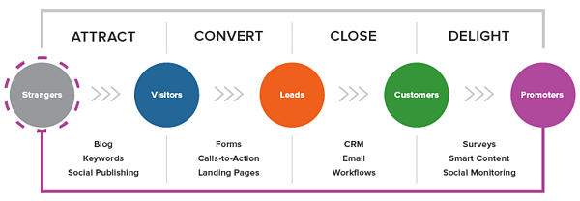

Slide 66
Lead Generation Process
First, a visitor discovers your business through one of your marketing channels
That visitor then clicks on your call-to-action (CTA)
That CTA takes your visitor to a landing page, which is a web page that is designed to capture lead information in exchange for an offer.
Once on the landing page, your visitor fills out a form in exchange for the offer

Slide 67
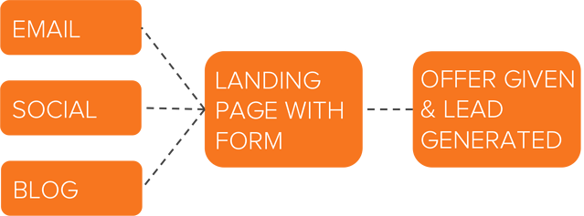
Lead Generation Marketing
Once you put all of these elements together, you can use your various promotional channels to drive traffic to your landing page to start generating leads.

Slide 68
Content
Content is a great way to guide users to a landing page. Typically, you create content to provide visitors with useful, free information. You can include CTAs anywhere in your content
Email
Email is a great place to reach the people who already know your brand and product or service

Slide 69
Blog
The great thing about using your blog posts to promote an offer is that you can tailor the entire piece to the end goal
Lead Generation Strategies
Facebook Lead Generation
Twitter Lead Generation
LinkedIn Lead Generation
PPC Lead Generation

Slide 70
Get more visibility online

Slide 71
Digital marketing is a strategic way to simultaneously build brand awareness and provide incredible value to online audiences.
The more targeted and intentional you are with your digital marketing efforts, the more visibility you’ll have online.

Slide 72
steps for increasing visibility in digital marketing.
Establish Your Brand’s Website
Create a Blog
Make SEO a Priority
Don’t Forget About Off-Site SEO
Utilize Social Media
Capitalize On Email Marketing
Invest In Paid Ads
Encourage Online Customer Reviews
Establish Content Partnerships
Work With Online Influencers

Slide 73
Ways to Increase the Visibility of Your Online Content
Followers: Quality Over Quantity
It’s tempting to focus on filling up your social media followers or blog subscribers with random people just to boost your numbers.
Engage With Peo
Engagement is one of the most fundamental strategies online marketers use to boost visibility
Post at the Right Time
While there isn’t one magical time when you should always post for the most visibility, you can increase the chance of people discovering your online content

Slide 74
Include Visuals
Including a visual on your web page, in your blog post or in your social media feed is one of the best ways to boost engagement and visibility.
Use Hashtags
Tagging your posts with hashtags helps more people see them.
Share Other People’s Content
When you share other people’s content, you’ll get your name in front of the person whose content you shared as well as their followers.

Slide 75
Share Your Own Content
Cross-promote your social media accounts to get more followers on all of them. Share your own content and others just might do the same.Your Own Content
Work on Personal Branding
Developing a clear, consistent brand for your business is crucial. But developing your personal brand can help make your company’s brand even stronger.

Slide 76
connect with your audience

Slide 77
One of the most important aspects of marketing is to connect to the target audience.
Connecting to the target audience is vital for any business or organization, particularly in order to determine how the target audience reacts to events, items, or situations.
The reactions of your target audience will directly relate to business growth

Slide 78
Who is your target audience?
If you’re going to connect with your audience, then you need to have a good, rough idea of who they are.
Typically, it might be a great idea to learn the demographics of your target audience and update that information frequently. his way, you can develop marketing strategies to help you connect with your audience.
Once you have that good, rough idea of who your target audience is, you’re going to want to get specific details in order to understand them better.

Slide 79
Roles of Your Target Audience
An important step in understanding your target audience is to go beyond learning their demographic information, and understand what role they play in the path to purchase. These roles can often be divided into the following categories:
The Decision Maker:
The Supporter:

Slide 80
Types of Target Audiences
Interest
Purchase Intention
Subcultures
Have clear buyer personas
Provide relevant content
Utilise your channels
Be responsive to feedback

Slide 82
link exchange

Slide 83
Link exchange is link building tactic whereby one or more websites exchange links. Such an exchange of links is discussed an agreed on beforehand and results in advertising opportunities for the websites involved. Link exchange may also be a factor influencing link popularity.

Slide 84
Assessment by search engines
The Google search engine assesses ​​inbound links according to various criteria such as quantity, quality, relevance, domain strength, and many other factors.
Inbound links can therefore influence Google ranking positively or negatively. However, Google Webmaster Central clearly speaks out against the manipulation of incoming links.
In other words, any attempt to generate links in an “unnatural way,” including through a link exchange, represents a violation of Google’s Webmaster Guidelines.

Slide 85
types of link exchange
Reciprocal
non-reciprocal

Slide 86
link exchange in SEO
Link exchange is a pretty straightforward process. In order to promote
your business on as many websites as possible, you would find your
partner website. After that, you would make a deal with that specific
website to market their business, while they market yours.
If you wanted to have your business featured on your partner's
website, you would need to do the same favor on your website.

Slide 87
What is link exchange in SEO today?
Search engines have noticed that these types of backlinks aren't really an honest measure of your website's reliability and popularity.
They have also realized that these links are just a way for businesses to boost their SEO rankings without much effort.

Slide 88
Websites you should avoid
Websites that are unrelated to your business's
Websites that look terrible
Websites that have a lot of outbound links.
New websites.
Websites that give out nofollow links.
Websites that send link exchange requests via e-mail.

Slide 89
Registering with directories

Slide 90
. directory makes a memorable web address for anyone who offers listings of people, places or files.
Whatever you catalog – residential listings, service providers, membership lists or even data for the software industry –. directory is where you belong.

Slide 91
How to Register a Domain Name
Part of creating a website, is buying a domain name that has to be unique.

Slide 92
What is a Domain Name?
A domain name is your unique identifier among billions of other websites on the web.
That’s why having a memorable and easy-to-type name is essential for having an online presence.

Slide 93
How to Register a Domain Name: 4 Options
Using Domain.com
Using GoDaddy.com
Using Namecheap.com
Using Bluehost web hosting (offers free domain for 1 year)

Slide 94
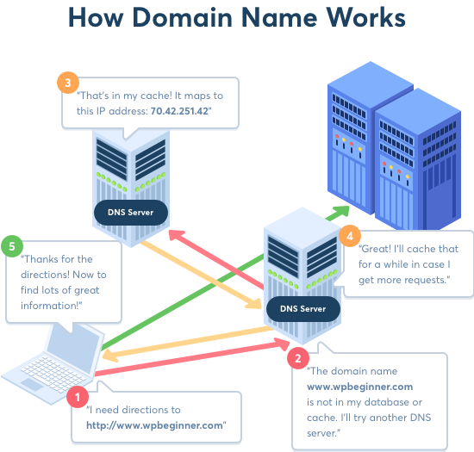

Slide 95
How to Choose the Best Domain Name
Domain names play a very important role in your website’s identity and success. This is why it’s important for you to carefully think about the domain name you choose
However, it’s also important to not overthink it otherwise you will never get past the research phase. Following are some general tips to keep in mind when searching for a domain name.

Slide 96
Data visualization

Slide 97
Data visualization is the process of translating large and complex datasets and summarizing them in a visual format.
This not only makes the data easier to understand but also pleasant to look at, which helps you get people’s attention more effectively. why or how data visualization is important for marketing analytics, here are a few reasons according to smart boost.

Slide 98
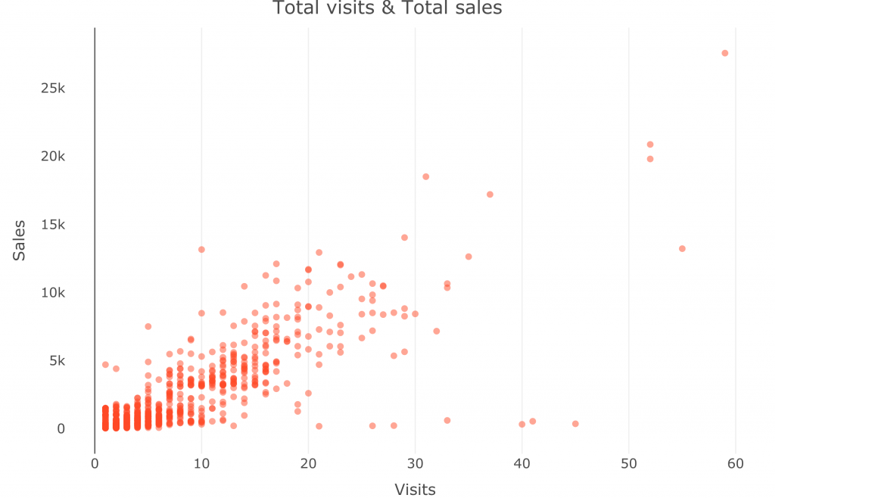
Types of Data Visualization
Bar Graphs
A bar graph presents categorical data with rectangular bars. We can count the values of various categories using bar graphs.
Pie Charts

Slide 99
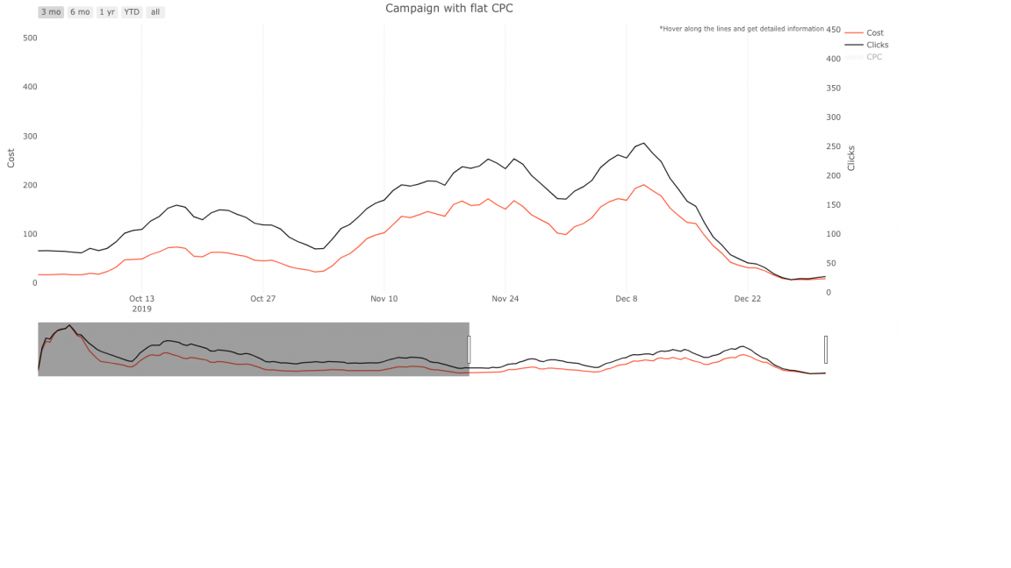
Scatter Plots
A scatter plot shows the relationship between two variables or categories of data.

Slide 100
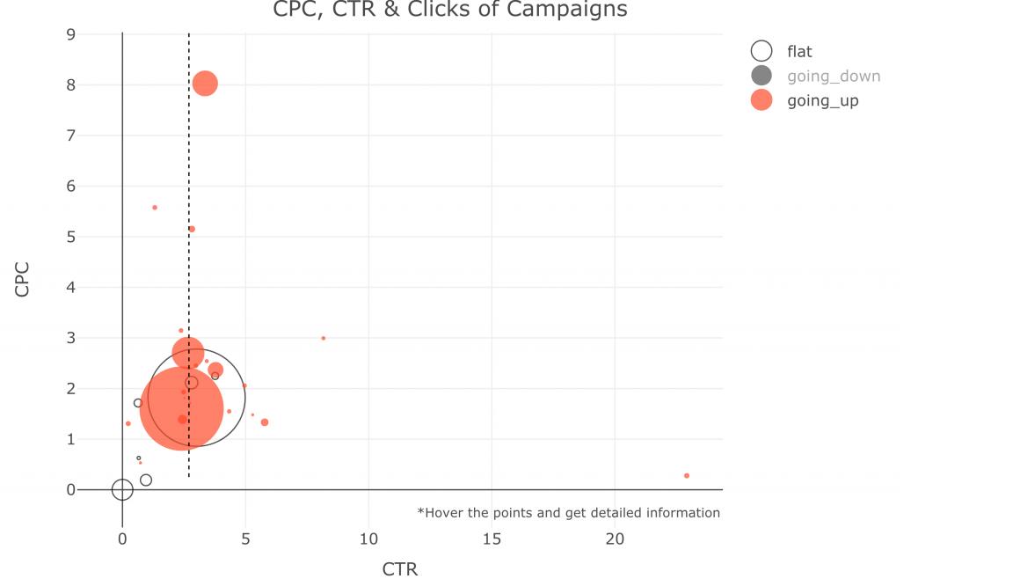
Heat Map
A heatmap is a graphical representation in which we use colors to represent data values that communicate the relationship between two variables.

Slide 101
Advantages of data visualization
Provide greater insight
Improve your decision-making process
Engage the audience

